Slide 1
Chapter 3 Discrete-Time Signals in the Frequency Domain

Slide 2
Chapter 3 Discrete-Time Signals in the Frequency Domain
The Continuous-Time Fourier Transform
(CTFT Review)
The Discrete-Time Fourier Transform
(DTFT)
Definition、Properties、Symmetry Relations
Theorems
Computation by Matlab, Unwrap function
Digital Processing of Continuous-Time Signals (Sampling, Recovery, Band-pass )

Slide 3
How to Represent the Discrete-Time Signal?
Time-domain →
(a weighted linear combination of delayed unit sample sequences.)
Frequency-domain →
Description of a sequence in terms of complex exponential sequences of the form{ }.
Notes:
The best approach is to represent the signal as a combination of some kind of the simplest signals which will pass through the system and produce a response. Combine the responses of all simplest signals, which is the system response for the original signal.

Slide 4
3.1 The Continuous-Time Fourier Transform
CTFT – continuous in time, continuous in frequency
x(t)
MOOC
t

Slide 5
Normally, is a complex function.
In polar form:
-----magnitude spectrum
-----phase spectrum
MOOC

Slide 6
Dirichlet conditions: exists if
Finite number of finite discontinuities and a finite number of maxima and minima in any finite interval.
(b) Absolutely integrable
a milder condition：
Notes:
However, the CTFT may exists for a finite-energy continuous-time signal that is not absolutely integrable. Ex: ideal LPF;
The CTFT can also be defined using ideal impulses for some functions that do not satisfy either (3.3) or (3.6).

Slide 7
FS - periodicity in time, discrete in frequency
Where:
x(t)
T₀

Slide 8


Example of CTFT
x_{a}(t)
1
t
|X_{a}(jΩ)|
1/α
Ω

Slide 9
Unit impulse δ(t)
δ(t)
Δ(jΩ)
1
0
t
0
Ω
1 ←→ 2πδ(ω)
This result could be got directly based on the symmetry of Fourier Transform.
Notes:
Unit impulse has uniform frequency density in whole frequency range, that means it has infinite wide band.
Constant 1 represents direct current signal, and its spectrum is non-zero only at 𝛺=0.

Slide 10
sin and cos
F[cosω₀t]= F[(e^{jω0t} + e^{-jω0t)}/2]= π[δ(ω + ω₀) + δ(ω - ω₀)]
F[sinω₀t] = F[(e^{jω0t} - e^{-jω0t)}/2j]= jπ[δ(ω+ ω₀) - δ(ω - ω₀)]
F[cos ω₀t]
F[sin ω₀t]
(π)
(π)
(jπ)
ω₀
-ω₀
ω₀
-ω₀
(-jπ)

Slide 11
Parseval’s Theorem
The total energy of x_{a}(t):
Energy Density Spectrum:
The energy over frequency range is:

Slide 12
3.2 Discrete-Time Fourier Transform 3.2.1 Definition
The discrete-time Fourier transform of a sequence is defined by :
It’s inverse transform:
MOOC
Discrete in time, periodicity in frequency

Slide 13
IDTFT Proof :
If X(e^{jω}) exists, then
Hence,
Notes:
The order of integration and summation can be interchanged if the summation inside the brackets converges uniformly, i.e. X(e^{jω}) exists.

Slide 14
DTFT is discrete in time, and periodicity in frequency
The DTFT X(e^{jω}) of a sequence x[n] is a continuous function of ω
It is also a periodic function of ω with a period 2π:
MOOC

Slide 15
Therefore
represents the Fourier series representation of the periodic function.
As a result, the Fourier coefficients x[n] can be computed from X(e^{jω}) using the Fourier integral.
MOOC

Slide 16
Example
The DTFT of the unit sample sequence δ[n] is given by

Slide 17
3.2.2 Basic Properties
In general, X(e^{jω}) is a complex function of the real variable ω and can be written in rectangular form:
X(e^{jω}) = X_{re}(e^{jω}) + jX_{im}(e^{jω})
Where, X_{re}(e^{jω}) and X_{im}(e^{jω}) are, respectively, the real and imaginary parts of X(e^{jω}), and are real functions of ω.
X_{re}(e^{jω}) = ½{X(e^{jω}) + X*(e^{jω})}
jX_{im}(e^{jω}) = ½{X(e^{jω}) - X*(e^{jω})}
MOOC

Slide 18
X(e^{jω}) can alternately be expressed in polar form:
X(e^{jω}) = | X(e^{jω}) |e^{jθ(ω)}
where
θ(ω) = arg{X(e^{jω}) }
| X(e^{jω}) | is called the magnitude function
θ(ω) is called the phase function
Both are real functions of ω.
MOOC
Notes:
In many applications, the DTFT is called the Fourier spectrum.
Likewise, | X(e^{jω}) | and θ(ω) are called the magnitude and phase spectra.

Slide 19
The relations between the rectangular and polar forms of X(e^{jω}) are given by:
X_{re}(e^{jω}) = | X(e^{jω})|cosθ(ω)
X_{im}(e^{jω}) = | X(e^{jω})|sinθ(ω)
|X(e^{jω})|² = X(e^{jω})X* (e^{jω}) = X²_{re}(e^{jω}) + X²_{im}(e^{jω})
θ(ω) = arctan(X_{im}(e^{jω}) / X_{re}(e^{jω}) )
For a real sequence x[n], | X(e^{jω}) | and X_{re}(e^{jω}) are even functions of ω, whereas, θ(ω) and X_{im}(e^{jω}) are odd functions of ω.

Slide 20
Note: X(e^{jω}) = | X(e^{jω}) |e^{j[θ(ω)+2πk]}
= | X(e^{jω}) |e^{jθ(ω)}
for any integer k.
The phase function θ(ω) cannot be uniquely specified for any DTFT.
Unless otherwise stated, we shall assume that the phase function θ(ω) is restricted to the following range of values:
-π≤ θ(ω) ≤ π
called the principal value (wrapped phase).
unwrapped phase -The continuous function of ω is derived from the original phase function by removing the discontinuities of 2π.

Slide 21
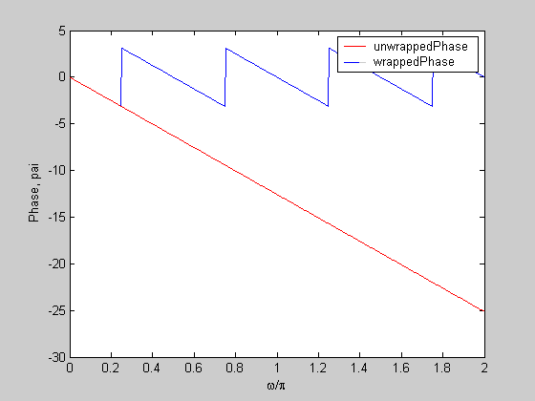
Wrapped Phase and Unwrapped Phase
Example:
Ө (ω)= - 4ω
MOOC

Slide 22
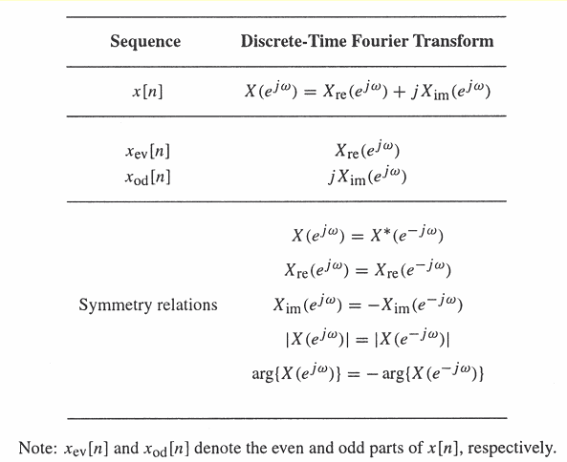
Symmetry relations of the DTFT of a real sequence
3.2.3 Symmetry Relations
MOOC

Slide 23
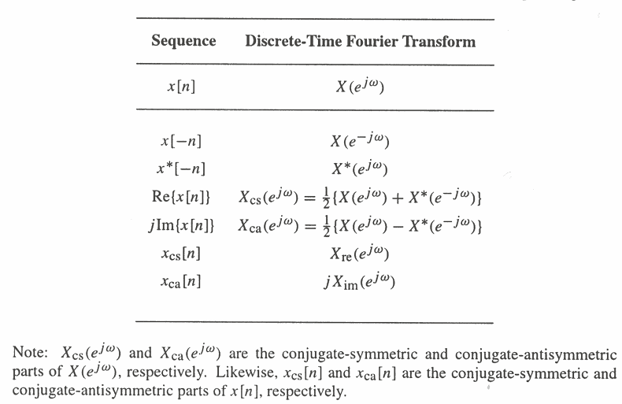
Symmetry relations of the DTFT of a complex sequence
MOOC

Slide 24
Example - Consider the causal sequence
as

Slide 25
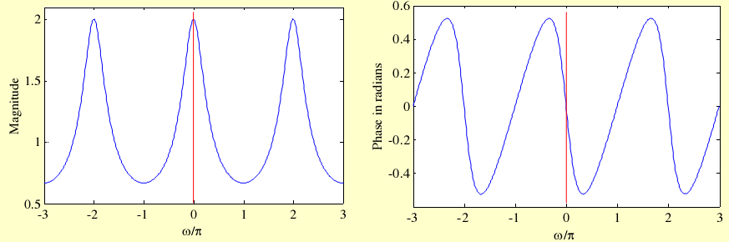
The magnitude and phase of the
X(e^{jω}) = 1/(1 – 0.5e^{-jω}) are shown below:
|X(e^{jω})|= |X(e^{-jω})|
θ(ω)=-θ(-ω)

Slide 26
3.2.4 Convergence Condition
If we denote:
The uniform convergence of X(e^{jω}):
The mean-square convergence of X(e^{jω}):
MOOC

Slide 27
Now, if x[n] is an absolutely summable sequence, i.e., if:
Then
for all values of ω.
Thus, the absolute summability of x[n] is a sufficient condition for the existence of the DTFT X(e^{jω}).
MOOC

Slide 28
Since
An absolutely summable sequence has always a finite energy.
However, a finite-energy sequence is not necessarily absolutely summable.
MOOC

Slide 29
Uniform convergence
Absolutely summable sequence.
Mean-square convergence
Finite-energy sequence

Slide 30
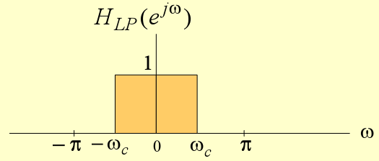
Example
MOOC
does not converge uniformly for all values of ω, but converge in the mean-square sense.
Notes:
Does not uniformly converge to H_{LP}(e^{jω}) for all values of ω, but converges to H_{LP}(e^{jω}) in the mean-square sense

Slide 31
h_{LP}[n] 的均方收敛特性：
The mean-square convergence property of the sequence h_{LP}[n] can be further illustrated by examining the plot of the function
The number of ripples increases as K increases with the height of the largest ripple remaining the same for all values of K
As K goes to infinity, the convergence of H_{LP,K}(e^{jω}) approximation H_{LP}(e^{jω}) in the mean-square sense.

Slide 32
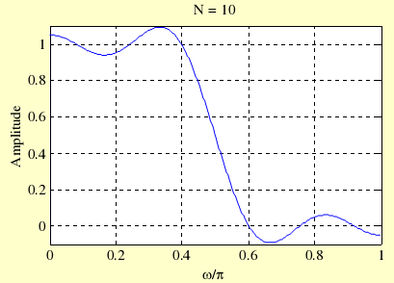
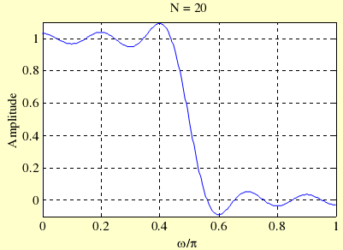
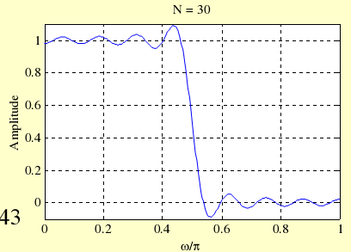
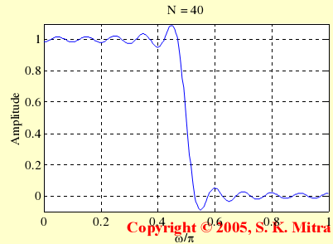
K = 10
K = 20
K = 30
Gibbs phenomenon
K = 40
Notes:
As can be seen from these plots, independent of the value of K there are ripples in the plot of H_{LP,K}(e^{jω}) around both sides of the point ω = ω_{c}

Slide 33
The DTFT can also be defined for a certain class of sequences which are neither absolutely summable nor square summable.
Examples of such sequences are the unit step sequence μ[n], the sinusoidal sequence cos(ω₀n+φ) and the exponential sequence Aα^{n}
For this type of sequences, a DTFT representation is possible using the Dirac Delta function δ(ω)

Slide 34
A Dirac Delta function δ(ω) is a function of ω with infinite height, zero width, and unit area
It is the limiting form of a unit area pulse function p_{Δ}(ω) as Δ goes to zero satisfying:
=1
ω
MOOC

Slide 35
Example - Consider the complex exponential sequence
Its DTFT is given by
where δ(ω) is an impulse function of ω and
MOOC

Slide 36
The function
is a periodic function of ω with a period 2π and is called a periodic impulse train or impulse train.
To verify that X(e^{jω}) given above is indeed the DTFT of x[n]=e^{jω0n} we compute the inverse DTFT of X(e^{jω})
MOOC

Slide 37
Thus
where we have used the sampling property of the impulse function δ(ω)
MOOC

Slide 38
Commonly Used DTFT Pairs
MOOC

Slide 39
3.2.5 Strength of a DTFT
The strength of a DT FT is given by its norm.
The Lp-norm of X(e^{jω}) is defined by:
p is a positive integer.
In practice, the value of p is typically 1 or 2 or .
M-file filternorm can be used to determine norms.

Slide 40
3.3 DTFT Theorems
Linearity
Time-shifting
Frequency-shifting
Differentiation- in-frequency
Convolution
Modulation
MOOC
Parseval’s relation
Notes:
There are a number of important theorems of the DTFT that are useful in signal processing applications.
These are listed here without proof; Their proofs are quite straightforward.

Slide 41
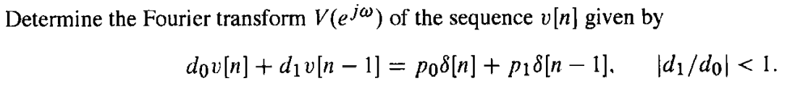
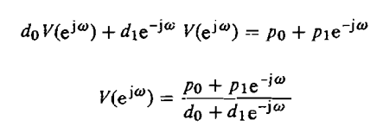
Ex. 3.11

Slide 42





Ex. 3.12

Slide 43



Ex. 3.13
MOOC

Slide 44
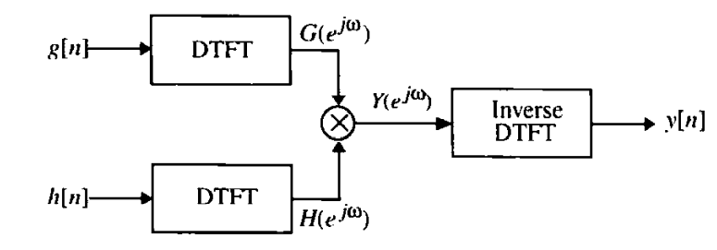
Ex. 3.14 利用DTFT求卷和
MOOC

Slide 45



MOOC

Slide 46
3.4 Energy Density Spectrum of a Discrete-Time Sequence
The total energy of a finite-energy sequence g[n] is given by
E
From Parseval’s relation we observe that
E
energy density spectrum
MOOC

Slide 47
Example 3.15 Compute the energy of the sequence
h_{LP}[n]=sinω_{c}n/πn, -∞<n<∞
Where,
Hence, h_{LP}[n] is a finite-energy lowpass sequence.

Slide 48


Ex. 3.16 Energy of the Exponential Discrete-Time Signal
From Parseval’s relation

Slide 49
3.1.3 Band-Limited Continuous-Time Signals
An ideal band-limited signal has a spectrum that is zero outside a frequency range
0<Ω_{a}≤| Ω |≤Ω _{b}<∞, that is
Band-limited signals are classified according to the frequency range where most of the signal’s energy is concentrated.
如图，80% 的信号能量集中在频率范围： 0≤|Ω|≤0.4898π
Notes:
A precise definition of the bandwidth depends on applications.

Slide 50
A lowpass continuous-time signal has a spectrum occupying the frequency range 0<|Ω|≤ Ω _{p}< ∞ , where Ω _{p} is called the bandwidth of the signal.
A highpass continuous-time signal has a spectrum occupying the frequency range 0< Ω_{p}≤|Ω|< ∞ and has a bandwidth from ω_{p} to ∞.
A bandpass continuous-time signal has a spectrum occupying the frequency range 0<Ω_{L}≤|Ω|≤Ω_{H}< ∞ and has a bandwidth of
Ω_{H} - Ω_{L}
Notes:
However,an ideal band-limited signal can not be generated in practice, and, for practical purposes, it is sufficient to ensure that the signal energy is sufficiently small outside the specified frequency range.

Slide 51
3.5 Band-Limited Discrete-Time Signals
A band-limited discrete-time signal has a spectrum that is limited to a portion of the frequency range -π≤ω≤π.
frequency range of lowpass discrete-time real signal: 0<|ω|≤ω_{p}<π, bandwidth is ω_{p}
frequency range of highpass discrete-time real signal: 0<ω_{p}≤|ω|<π , bandwidth is π- ω_{p}
frequency range of bandpass discrete-time real signal: 0<ω_{L}≤|ω|≤ω_{H}<π, bandwidth is ω_{H}-ω_{L}
Notes:
Since the spectrum of a discrete-time signal is a periodic function of ω with a period 2π, a full-band signal has a spectrum occupying the frequency range -π≤ω≤π.
A band-limited discrete-time signal has a spectrum that is limited to a portion of the frequency range -π≤ω≤π.

Slide 52
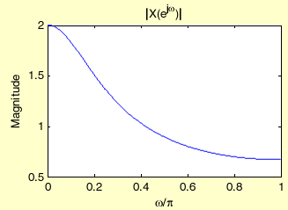
Example:
Consider the sequence
x[n]=(0.5)^{n}μ[n]
Its DTFT is
Its magnitude spectrum shown below on the right.
It can be shown that 80% of the energy is contained in the frequency range 0≤|ω|≤0.5081π
Notes:
Hence, we can define the 80% bandwidth to be 0.5081π

Slide 53
3.7 The Unwrapped Phase Function
In numerical computation, when the computed phase function is outside the range [-π, π], the phase is computed modulo 2π, to bring the computed value to this range.
Thus, the phase functions of some sequences exhibit discontinuities of 2π radians in the plot.
In such cases, often an alternate type of phase function that is continuous function of ω is derived from the original phase function by removing the discontinuities of 2π.
Process of discontinuity removal is called unwrapping the phase.
The unwrapped phase function will be denoted as θ_{c}(ω).
In Matlab, this can be done by using unwrap.
Notes:
当计算出的相位函数在 [-π, π] 之外，就按 2π取模, 使相位值在[-π, π]内；这样会造成一些相位函数出现跳变 2π 的不连续图形。
通过移除 2π 的不连续，得到ω的连续函数，称为：unwrapped phase function θ_{c}(ω)
但要注意，相位函数本身固有的间断点不能通过unwrap去掉！

Slide 54
3.6 DTFT Computation Using MATLAB
The function freqz ,abs, angle, unwrap can be used to compute the values of the DTFT of a sequence, described as a rational function in the form of
H = freqz(num, den, w)
num and den containing the coefficients {p_{i}} and {d_{i}} respectively.
Notes:
H = freqz(num, den, w) returns the frequency response values as a vector H of a DTFT defined in terms of the vectors num and den containing the coefficients {p_{i}} and {d_{i}}, respectively at a prescribed set of frequencies between 0 and 2π given by the vector ω.
The functions of real, imag, abs, angle compute the real and imaginary parts, and the magnitude and phase of the DTFT.
There are several other forms of the function freqz.

Slide 55
Example
Plots of the real and imaginary parts, and the magnitude and phase of the DTFT

Slide 56
% Program 3_1: Discrete-Time Fourier Transform Computation
num = [0.008 -0.033 0.05 -0.033 0.008];
den = [1 2.37 2.7 1.6 0.41];
w = 0:pi/255:pi;
h = freqz(num, den, w); % Compute the frequency responses
subplot(2,2,1)
plot(w/pi,real(h));grid
title('Real part'); xlabel('\omega/\pi'); ylabel('Amplitude')
subplot(2,2,2)
plot(w/pi,imag(h));grid
title('Imaginary part'); xlabel('\omega/\pi'); ylabel('Amplitude')
subplot(2,2,3)
plot(w/pi,abs(h));grid
title('Magnitude Spectrum'); xlabel('\omega/\pi'); ylabel('Magnitude')
subplot(2,2,4)
plot(w/pi,angle(h));grid
title('Phase Spectrum'); xlabel('\omega/\pi'); ylabel('Phase, radians')
figure, plot(w/pi,unwrap(angle(h)));
title('unwrapped Phase Spectrum'); xlabel('\omega/\pi'); ylabel('Phase, radians')

Slide 57
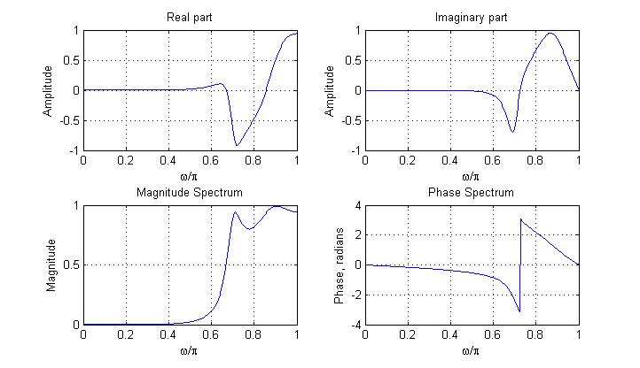

Slide 58
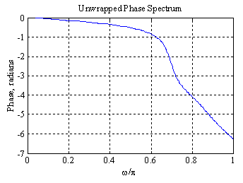
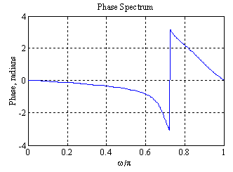
The phase spectrum displays a discontinuity of 2π at ω = 0.72
This discontinuity can be removed using the function unwrap as indicated below:

